Slide 1
Hidden Transcripts
Oct 29, 2019

Slide 2
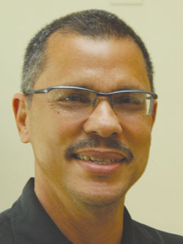
Meeks – Narratives of Resistance (2000)
Question:
  How to understand failed/inept rebellion?
    In a way that recognizes the ideas and actions of the public
Why does this matter?
  Conventional understandings of revolution privilege elite ideas
    And see the public as passive recipients of ideas from elites
At stake:
  Subaltern account of revolution
    Account of revolution told from vantage point of marginalized peoples often denied “voice”
Brian Meeks – Caribbean political economist

Slide 3
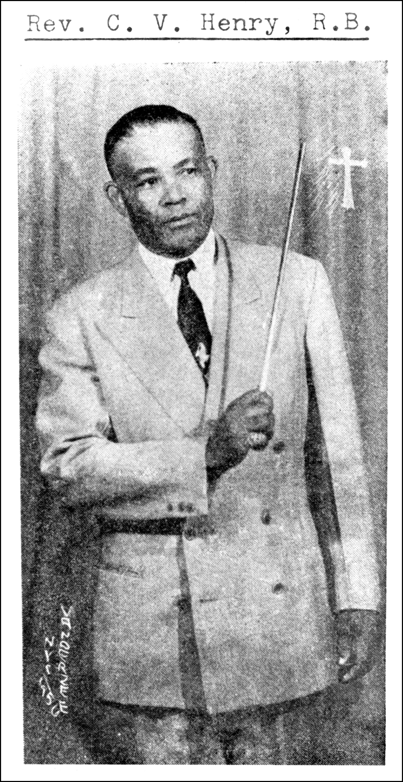
The Henry Rebellion
Background
“Othering” of Rastafari
  Non “brown bourgeoisie” forms of sociality
    Alternative values, dress, language, economy
  Viewed as security threat
    Vanguard of Marxism following 1959 Cuban revolution
  Targeted by police
    Beginning in 1930s, began arresting leaders, destroying camps
Claudius Henry

Slide 4
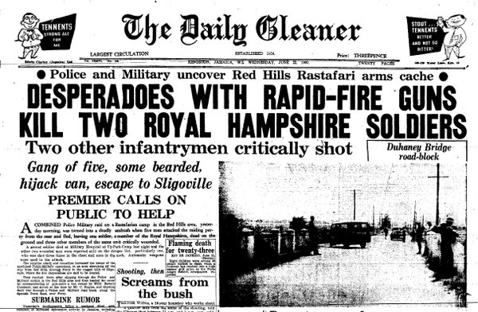
The Henry Rebellion
Details:
  Key events:
    6 April 1961 – raid on African Reform Church of Claudius Henry
      Leaders, trainers arrive from US, May-June 1961
    20 June 1961 – raid on Ronald Henry’s Red Hill camp
    27 June 1961 – Ronald Henry and three followers apprehended
Front-page news in the Gleaner: the most significant threat to post-1938 Jamaican state legitimacy

Slide 5
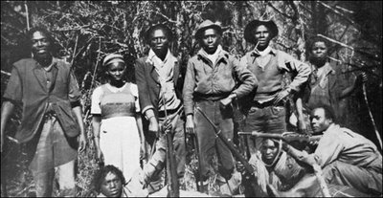
The Henry Rebellion
But beneath these events…
  Ongoing clandestine cross-country planning of revolution
    C. Henry – letter of support for Cuban Revolution
    Close ties with Rastafarian sects
      NB: important role in pan-African, anti-colonial movements
    Recruitment of American participants
      On premise of retaking “African” colony
    Stockpiling arms
    Training recruits
How to read these events?
Fighters of the Kenyan Land and Freedom Army (1940s-1960s): important influence on militant Rastafari in Jamaica

Slide 6
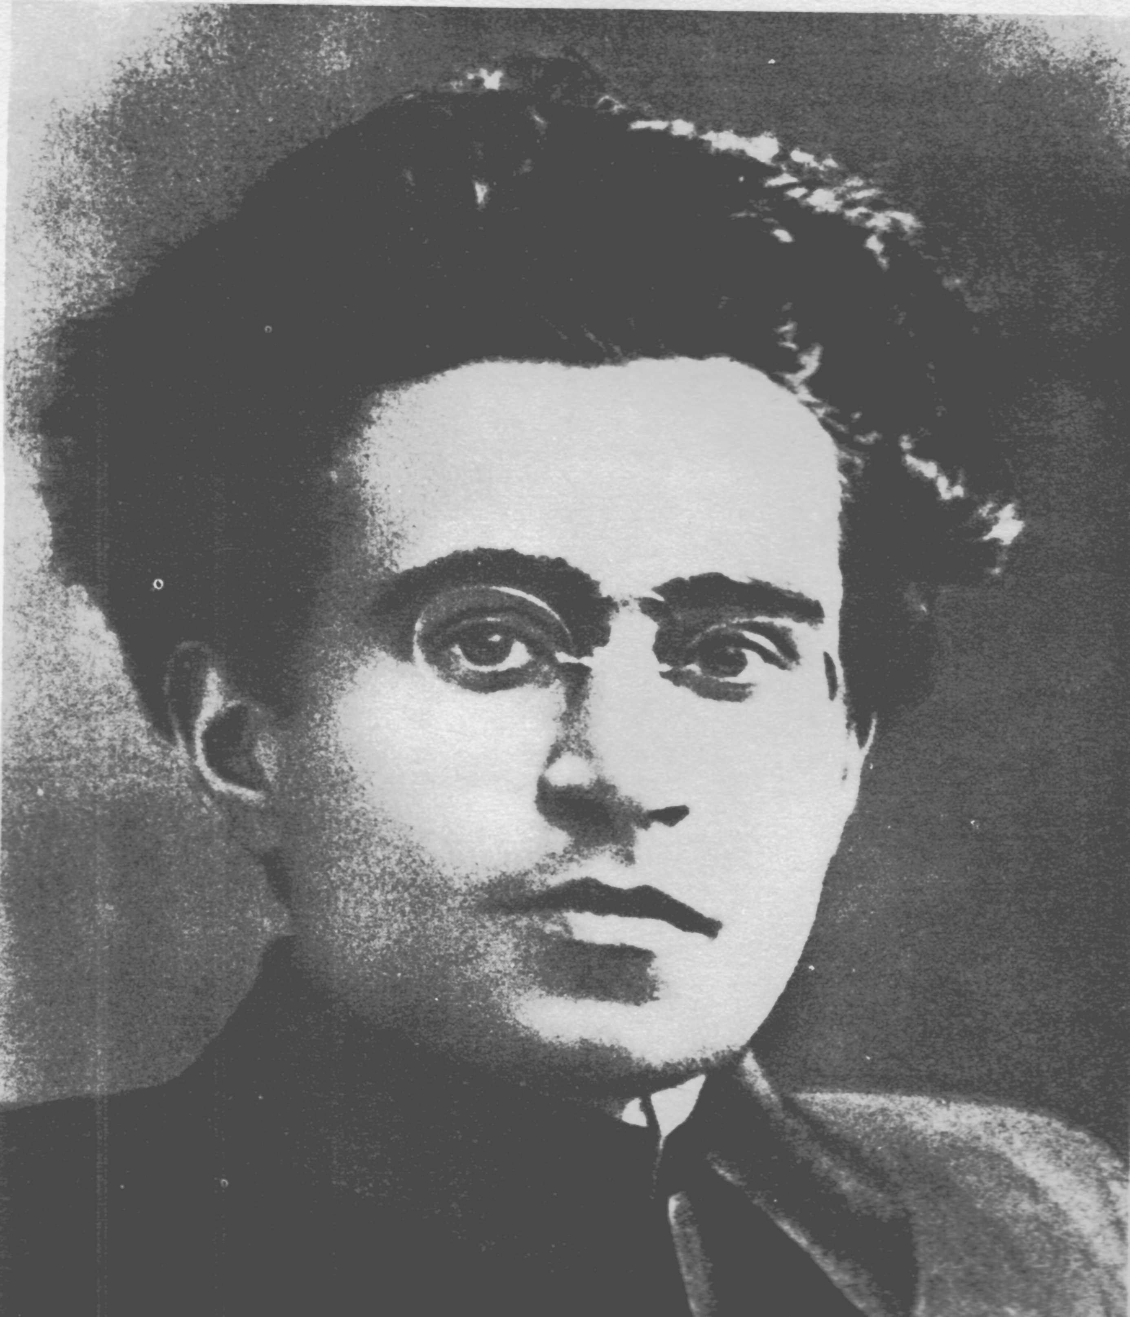
‘Hidden transcripts’ of resistance
Sympathetic critique of Antonio Gramsci’s understanding of consent
  Gramsci: working class consent to their domination
  Consent produced through ideology
    Organic ideology: beliefs, worldview that “naturally” grows out of dominant political economic system
    Contradictory ideology: alternative set of beliefs, practices imposed from “outside”
  But there are limits…
Antonio Gramsci

Slide 7
Problems with Gramsci…
“Consent,” “contradictory consciousness” both suggest that marginalized populations are not active participants in shaping revolutionary action
  Assume that the movement from reformism to revolution will be driven by intellectual elites
  But this obviously goes against the history of resistance in both the wider colonial world and in the Caribbean
Alternative: “hidden transcripts”

Slide 8
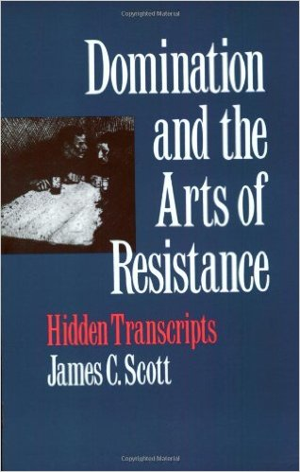
Public Transcript
Scott: appearance of consent is strategic
  Resistance occurs in situations of considerable power imbalance
    Dominant power could exterminate resistance
Appearance of consent occurs in official/public transcript
  Performance of “proper” roles, attitudes, behaviors, responsibilities for both rulers and ruled
  Reinforces rulers’ vision of ideal social reality
    E.g.: Plantation society relied on Othering to construct roles…
    What was the public transcript for slaves, freed slaves?
  BUT: public transcript are “performed”

Slide 9
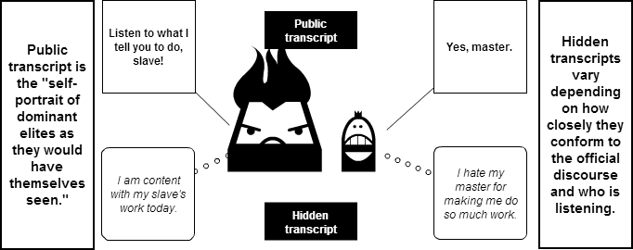
Resistance occurs in ‘hidden transcripts’
Resistance occurs in the hidden transcript
  Strategically use prescribed roles, language of the master to resist
    E.g., “rumour, gossip, disguises, linguistic tricks, metaphors, euphemisms, folktales, ritual gestures, anonymity” (Scott, 137)
    Express through conversations, folklore, jokes, songs, etc., in “offstage” sites
  Cultural, psychic space of alternative value systems
    “a veiled discourse of dignity and self-assertion within the public transcript… in which ideological resistance is disguised, muted and veiled for safety’s sake” (Scott, 137)

Slide 10

Hidden Transcripts
Hidden transcripts signal the presence of multiple, co-existent life-worlds in the present
  Categories, practices, and performances can have multiple and divergent meanings at one and the same time
  What appears deferential (or incompetent) in the dominant transcript can be an act of resistance in the hidden transcript
  NB: connects with Caribbean as “hybrid” space
Cover art for Akosua Adoma Owusu’s “Kwaku Anansi”

Slide 11
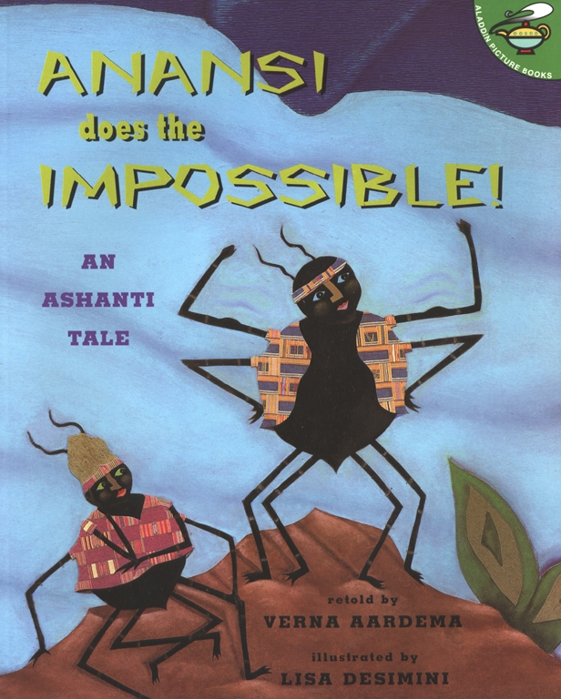
Hidden Transcripts
Marginalized peoples inhabit multiple worlds
  Same action can have very different meanings in the dominant and hidden transcript
  Preserves space for resistance in the face of overwhelming power
Enables us to rethink the significance of ‘spectacular’ uprisings…

Slide 12
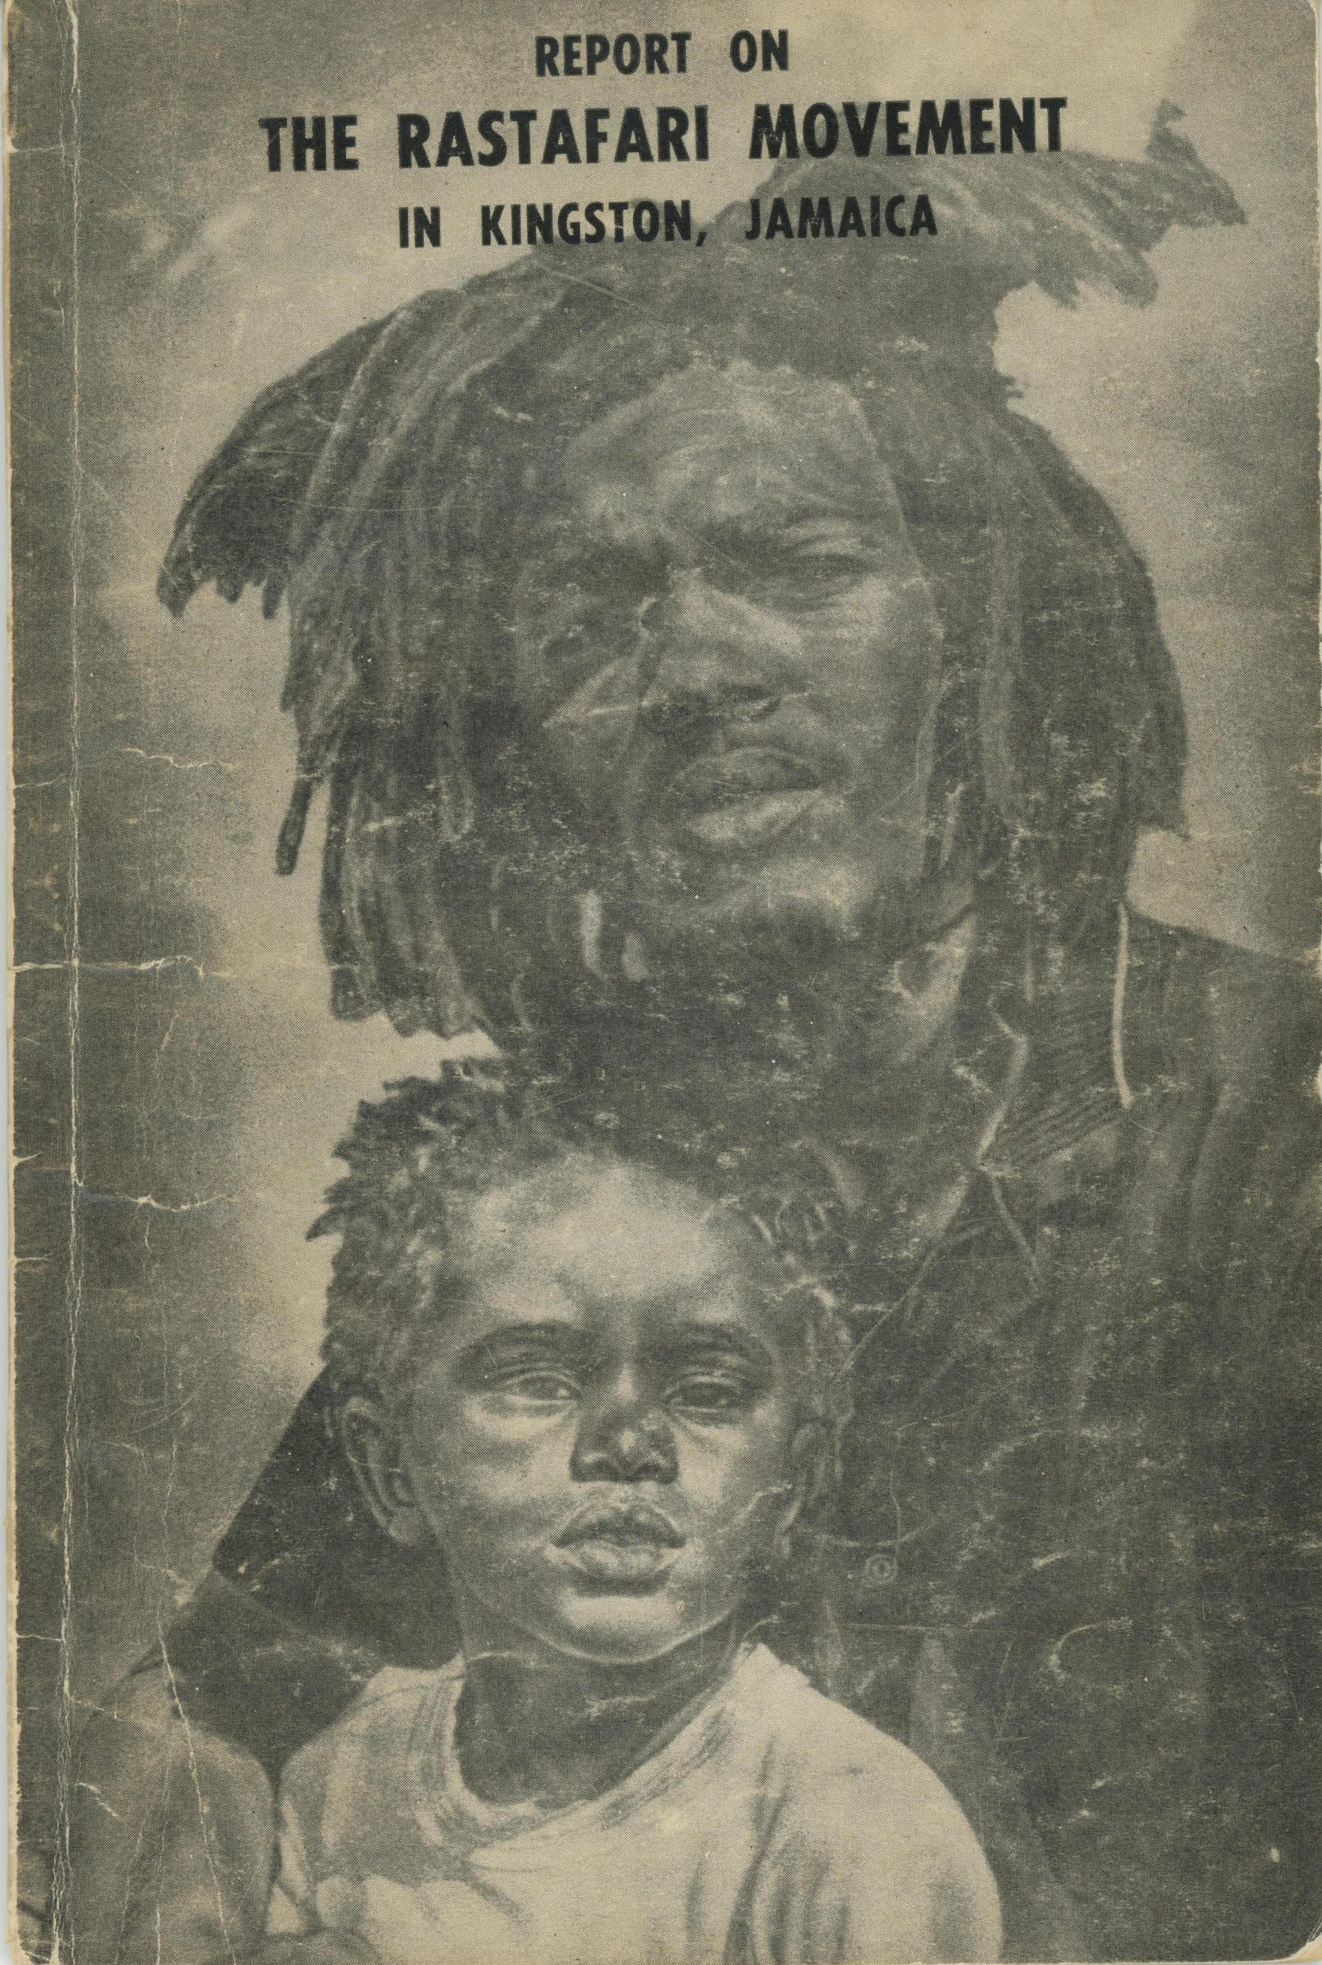
The Henry Rebellion
How is the Henry Rebellion an expression of Jamaica’s hidden transcript?
  Or, “transcript from below”?
What was the “official transcript” of Jamaican order?
  Collective identity?
  Political institutions?
  Economic strategy?
How did Henry subvert the official transcript?
Attempting to ”domesticate” the anti-colonial Other: British report on the Rastafari movement

Slide 13
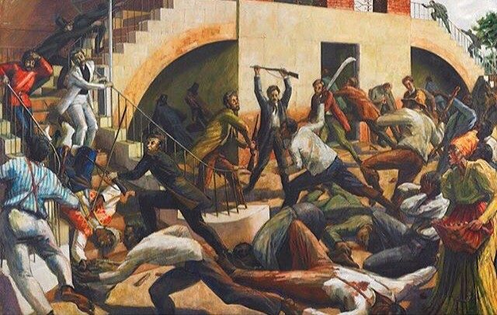
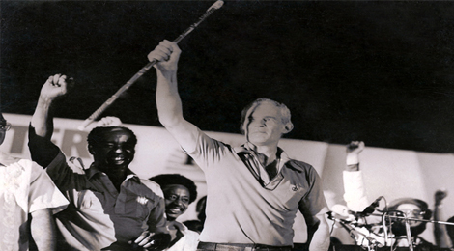
History of Jamaica’s Hidden Transcript
Jamaican history has been driven by the periodic emergence of resistance outside the hidden transcript
  1865 Morant Bay Rebellion →
  (brown) bourgeois nationalism
  1938 labor riots →
  clientelist political party system
  1970s democratic socialism →
  neoliberal structural adjustment
Morant Bay rebellion (1865, above);
Michael Manley with his rod of correction (below)

